Slide 2
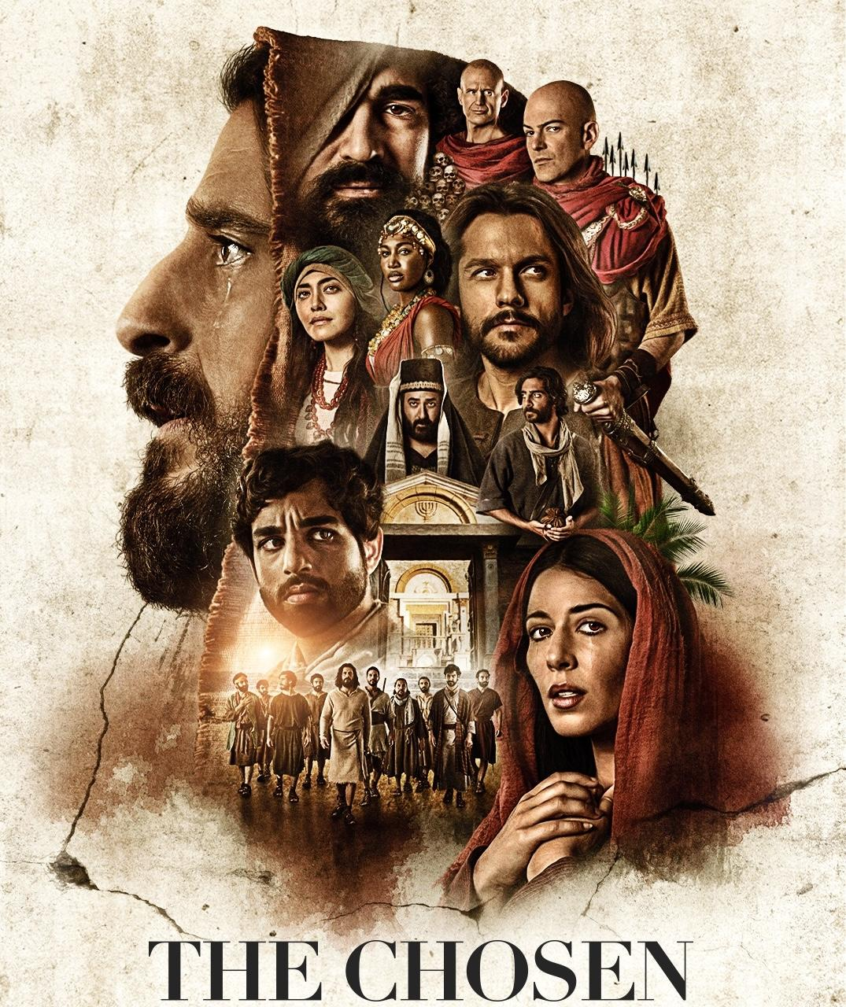
The History
Based on a short film for
a megachurch
Christmas Eve service
Became one of the
biggest crowdfunded
media projects - $11 Million from 16,000 initial investors
First appeared in 2019,
but found its audience during the global pandemic.

Slide 3
The Background
Executive Producer is
Dallas Jenkins, son of
Jerry B. Jenkins, co-author of the best-selling
Left Behind franchise.
Initially a product of
Angel Studios but now
part of a global distribution
deal with Lionsgate.
Predominantly filmed in rural Texas but also in parts of Utah.

Slide 4
The Background
Consult multiple sources
in writing for the show
to get the most accurate
cultural and historic picture possible - a Bible scholar,
a Roman Catholic Priest, and
a Messianic Jewish Rabbi
for Seasons 1 - 3.
Added a small
“Jewish advisory board”
for Season 4 to solicit more traditional Jewish input
and perspective.

Slide 5
The Impact and Appeal
200 million viewers worldwide*
9.8 / 10 average rating
on IMDB and a 99%
average audience score
on Rotten Tomatoes.
Sold $63 million in theatrical ticket sales after becoming
the first series to screen an entire season in theaters.

Slide 6
The Impact and Appeal
Drew 12,000 fans to appear
as extras over three days
of filming, making their
own costumes, and paying $1,000 each for the privilege!
ChosenCon:
Two years running
5K in attendance
Half of viewers are
practicing Christians?

Slide 7
The Plans for the Future
7 Seasons in total envisioned
Season 6 all focused
on one day in the life of Jesus
- the Crucifixion
“Jesus Cinematic Universe”?
A Chosen Sequel:
The Book of Acts
Old Testament Narratives:
Noah’s Ark? Moses?
Ruth and Boaz?
Animated series for kids?

Slide 8
Visual Portrayals
of Jesus

Slide 10
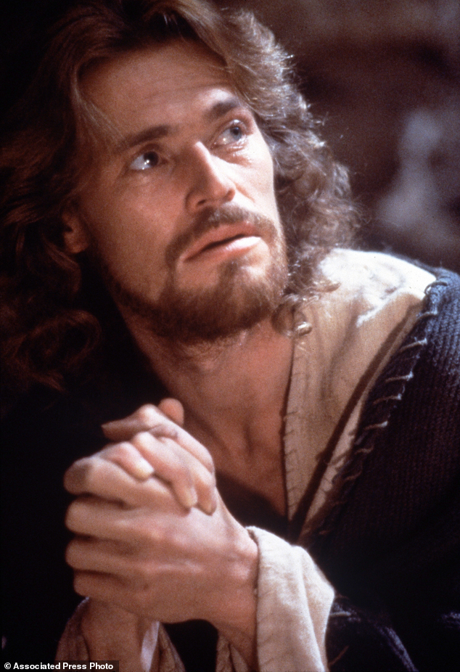
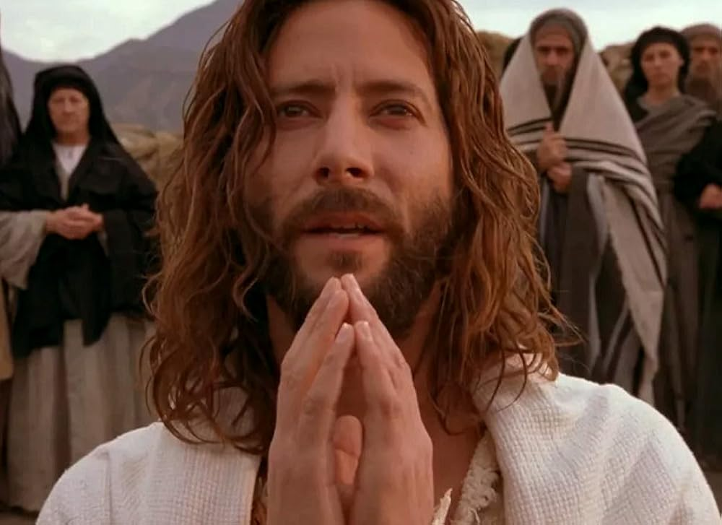
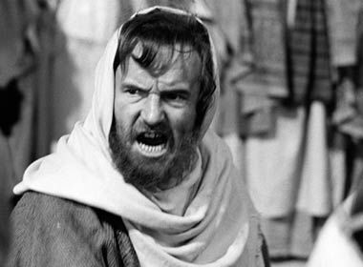

Slide 11
Visual Portrayals of Jesus
Portraying Jesus visually
always has been
a matter of interpretation
and the results have ranged from
tasteful to laughable
but all they tend to be
vastly subjective,
even individualistic
- dictated more by the artist chooses to see Jesus - often looking much like themselves
- rather than seeing themselves through the eyes of Christ.

Slide 12
Visual Portrayals of Jesus
Some of these portrayals stick, however, and can indelibly frame
how we picture - how we see and hear Jesus as we read the Bible
- so much so we have a hard time seeing Jesus any other way.

Slide 13
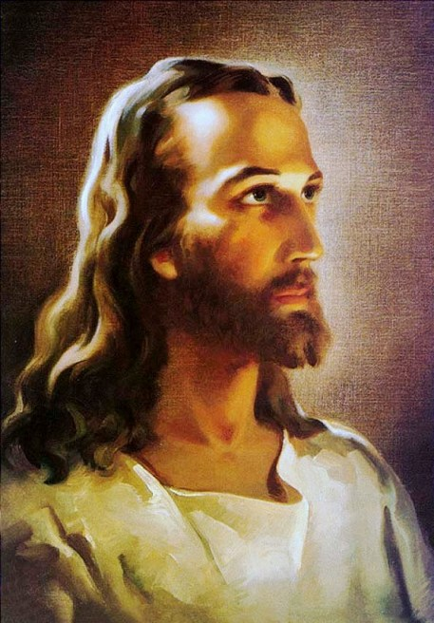
‘Head of Christ’
- Warner Sallman
This is an extraordinarily popular image of Christ,
said to have sold
over 500 million copies.
This portrait of Jesus
was a staple in many Christian homes over
the last couple of decades.

Slide 14
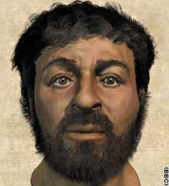
From the cover of Popular Mechanics in December 2002.
Using forensic anthropology,
the same science used to create more historical depictions of dozens of famous faces, including the father of Alexander the Great and King Midas of Phrygia, Israeli and British anthropologists and computer programmers presented
a likely representation of Jesus that was in sharp contrast to earlier, more deeply ingrained depictions of Christ.
Thus, many Christians protested.
Notes:
https://edition.cnn.com/2002/TECH/science/12/25/face.jesus/
Popular Mechanics 2002 Cover

Slide 15
Jesus: Fully Divine
And Fully Human
When it comes to picturing Jesus not in a static sense
but engaging life on this earth, we have to interpret the
long-held conviction
of the Christian faith
that Jesus was fully human and fully divine.
And how exactly does that translate onto the screen?

Slide 16
Jesus: Fully Divine
And Fully Human
At best, most of us
operate with either
a ‘basically human’
or a ‘basically God’
concept of Jesus,
sometimes vacillating between the two at different times
but never quite able to live within the tension of the two being held together in Christ.

Slide 17
Jesus:
Fully Human But Not Divine
If we think Jesus is just human,
then we are saying God cannot or will not demean Godself to come and live in the physical world, and that means
the physical world can never truly carry
the presence of God to us.
It also means Jesus cannot be
the full revelation of God and thus
there remains a gap between humanity and
the divine. It means that, however special and significant Jesus may be, he is still just
a human being; he may be even more important than the greatest of the prophets but, like them, he can only speak of God;
he cannot speak as God and ultimately change our situation, because he has nothing to offer
that is not already part of
the human experience.

Slide 18
Jesus:
Fully Divine But Fully Human
On the other hand, if we think Jesus is
just God, disguised as a human being,
then there is still a sense God cannot
truly enter into the human condition
and live and suffer and die with us and that
the created world and our physical being is
not valuable to God in itself,
but must have some external divinity
added to it before it can be saved.
While it’s important not to over-emphasize Jesus’ humanity, this is not the same thing
as making Jesus too human. In our fear of misrepresenting Jesus, we run the risk of stripping him of his humanity and rejecting all depictions of him in any medium
that we deem as insufficiently holy or majestic.
But God became human for a reason.

Slide 19
Jesus:
Fully Divine But Fully Human
The issue is not what kind of person Jesus was; what is important is
he was a person
- a fully human person.
Jesus is fully human, and so we can be confident that He has shared our birth,
our life and our death to be with us;
AND Jesus is fully God,
so as He shares our birth, life and death, he brings the eternal and undying life and love of God
into our world, so that new possibilities of forgiveness, renewal and resurrection open up.

Slide 20
Jesus in The Chosen
The Chosen does a notable job of bringing Jesus of Nazareth to life
on the screen, making the
Jewish Messiah feel less like
a stained-glass icon and more like
a human being. Albeit, a divine one.
While there's nothing wrong with
iconic, "stained-glass" portrayals,
The Chosen in seeking to make Jesus relatable, not only reminds us he too, despite being the Son of God,
is equally and fully human
but also makes Christ more accessible to general audiences without sacrificing his message
- the Gospel - in return.

Slide 21
What’s Different About The Chosen
In the Bible and screen adaptations past,
Jesus is the center of attention.
He is always the one preaching, the one healing, the one leading the action. Overall, what we watch is a visual portrayal of what the Gospels already show and tell us.
But we don’t learn or gain any insight as to
how to follow Jesus - what the journey
of faith is practically and tangibly like
from all those around and with Jesus.

Slide 22
What’s Different About The Chosen
The Chosen, while a show about Jesus
is told through the lives of his followers and others caught up in his ministry.
While the person, teachings, and works of Jesus remain front and center,
the imagined lives and personalities of
the women and men who follow him
explode into the foreground
- people in whom we can find traces of ourselves.

Slide 23
What’s Different About The Chosen
In the imaginative telling of the “backstory” of these men and women - including how the norms and values of the ancient Roman world shaped their perspective and desires
- much as our modern world shapes ours - The Chosen shows the profound tension between following the ways of the world and following the way of Jesus and illustrates the gradual changes that happen as people begin to think, speak, and act differently
after they choose to follow Christ.

Slide 24
What’s Different About The Chosen
As Jesus becomes their new and primary model of how to live - to view themselves,
to engage each other, and to be in the world,
we witness people like us who have
small hopes at the beginning of the show evolve into people who want great things
- the things of the Kingdom of God.
And as we watch these people change
as followers of Jesus, we are drawn into
the mystery of their transformation in Christ.

Slide 25
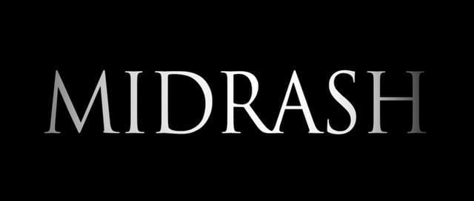
To fully capture this, however, there needs to be
a willingness and creativity in imagining
what the Bible leaves out.
And there is precedent for this
within ancient and modern Judaism
known as midrash.

Slide 26
Midrash is the long standing practice within ancient and modern Judaism of telling stories around
the edges of faith - crafting tales that extend
the stories of Torah and other scriptures
that fill the gaps between the lines of the Bible
while remaining firmly rooted in the character
and will of God as revealed in the Scriptures.

Slide 27
Early Christians told stories, too, prodigiously.
They fleshed out many stories about Jesus only alluded
to in the biblical canon, like Jesus’ descent into hell
that we refer to in the Apostles’ Creed.
The purpose of such stories was illustrative
- not defining. They sought to shed more light on
what the Bible already clearly reveals about
the character of Christ, the truth and power
of Gospel, the in-breaking of the Kingdom of God.

Slide 28
Still, We Must Pay Attention to
The Chosen’s Disclaimer
The Chosen makes some changes
that aren't found in the biblical narrative.
There are entire plotlines and characters
not found in the New Testament text
and the series is clear that it's nothing more than an entertaining door to a larger conversation.

Slide 30
Still, We Must Pay Attention to
The Chosen’s Disclaimer
The Chosen is NOT a replacement for
the Bible. While the show may be about
the life of Jesus, but it's meant to draw us
to the book that'll truly introduce us to Him, not replace that book.
The Chosen, properly embraced,
points to the need to read the Bible and to become a part of the Christian community, the Church to learn more about Jesus and what it means and looks like to follow him.

Slide 31
So, Don’t Get Too Attached
to the Characters in The Chosen
Imaginative speculation on biblical figures, while not controversial, is NOT
the same thing as scriptural revelation
about those figures.
A quick example:
Mind the tragic misrepresentation
of Mary Magdalene in the Church today.

Slide 33
And, Don’t Get Invested
to the Characters in The Chosen
Not Found in the Bible
Presumed or invented biblical characters
are NOT historical, biblical persons:
A quick example:
There is no Innkeeper in
the biblical account of the Nativity.

Slide 35
How We Will Watch
and Study The Chosen
We will NOT study
and reflect on Scripture
via The Chosen
- turning an artistic portrayal of the Gospel
into our interpretive lens
for reading and understanding the Bible.

Slide 36
How We Will Watch
and Study The Chosen
We WILL study
and reflect on The Chosen via the revelation
of Scripture
- as an illustration of
the character of Christ,
and the truth and invitation of the Gospel.

Slide 37
How We Will Watch
and Study The Chosen
How does The Chosen reflect the character of Christ?
How does The Chosen communicate the imperative of the Gospel - why it is good news and what difference does it make?

Slide 38
How We Will Watch
and Study The Chosen
How does
The Chosen offer us
an illustrative window into what it looks like
to follow Jesus AND
a person’s life change and gradual transformation
in following Christ?

Slide 39
How We Will Watch
and Study The Chosen
How does
The Chosen
not just reinforce
but challenge
what we believe
and understand about practicing and
living out of the faith
- following Jesus?

